Slide 1
Pointers and Arrays

Slide 2
CONTENTS
1. Quick Review of Arrays
One-Dimensional Arrays
Two-Dimensional Arrays
Multidimensional Arrays
2. Pointer Notation and Arrays
Differences Between Arrays and Pointers
3. Using malloc to Create a One-Dimensional Array
4. Using the realloc Function to Resize an Array
5. Passing a One-Dimensional Array
Using Array Notation
Using Pointer Notation

Slide 3
Pointers and Arrays
An array is a fundamental data structure built into C
A thorough understanding of arrays and their use is necessary to develop effective applications
Array and pointer notations are closely related to each other and can frequently be used interchangeably
in the right context
Understanding a difference between array and pointer will help you avoid incorrect use of these notations
In this chapter, we will address the fundamental aspects of arrays as they relate to pointers to provide you
with a deep understanding of arrays and the various ways they can be manipulated with pointers

Slide 4

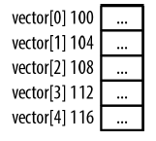

One-Dimensional Arrays
A one-dimensional array uses a single index
Array indexes start with 0 and end at one less than their declared size

Slide 5
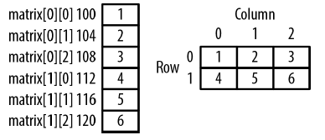

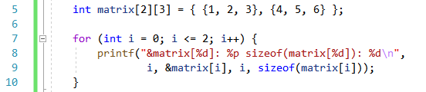

Two-Dimensional Arrays
Two-dimensional arrays use rows and columns to identify array elements

Slide 6
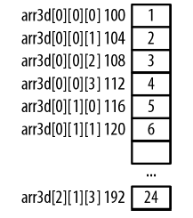
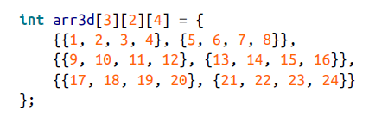
Multidimensional Arrays
Three-dimensional arrays consisting of rows, columns, and a rank

Slide 7

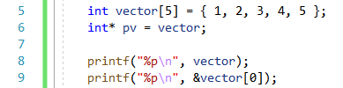

Pointer Notation and Arrays
When an array name is used by itself, the array’s address is returned
We can assign this address to a pointer
The variable pv is a pointer to the first element of the array (not the array itself)
We can use either the array name by itself or use the address-of operator
) =
Using the address-of operator is more verbose but also more explicit

Slide 8
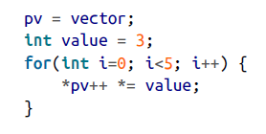
The notation pv[i] is evaluated as *(pv + i)
Adding an integer to a pointer will increment the address it holds
The same is true adding an integer to the name of an array
We can use of pointers in the implementation of the scalar addition operation
*(pv + i)
=
*(vector + i)

Slide 9

Differences Between Arrays and Pointers
The code generated by vector[i] is different from the code generated by vector+i
vector[i]: generates machine code that starts at location vector, moves i positions from this
location, and uses its content
vector+i: generates machine code that starts at location vector, adds i to the address,
and then uses the contents at that address
- While the result is the same, the generated machine code is different

Slide 10
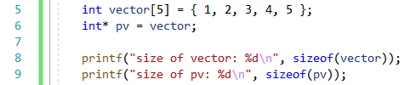

There is a difference when the sizeof operator is applied
The number of bytes allocated to the array
The pointer’s size

Slide 11
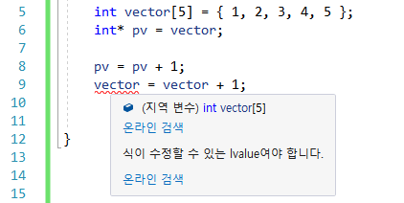
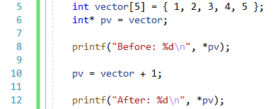

The pointer pv is an lvalue
An lvalue is the lefthand side of an assignment operator, and must be capable of being modified
A pointer can be assigned a new value and reference a different section of memory
The address assigned to an array cannot be changed
// ok

Slide 12
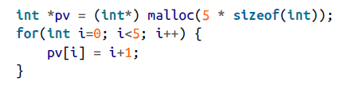

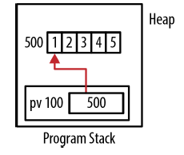
Using malloc to Create a One-Dimensional Array
The array notation is often easier to follow
Remember to deallocate the memory when we are through with it

Slide 13
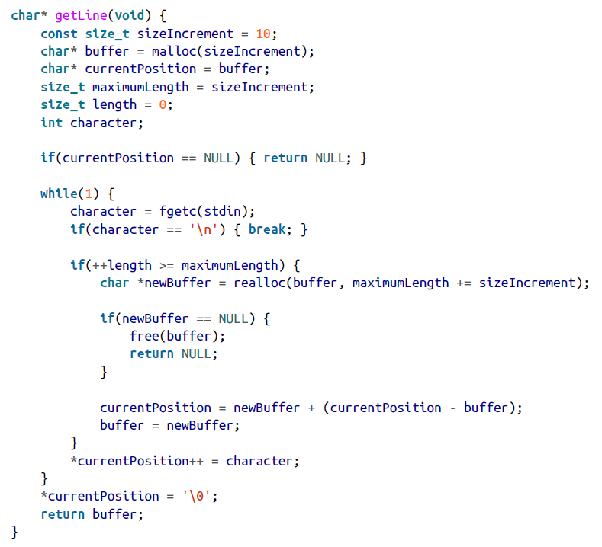
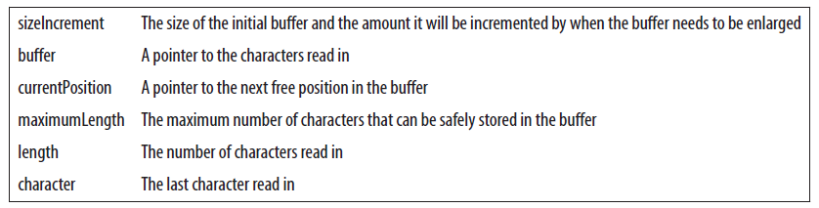
Using the realloc Function to Resize an Array
Exceeded the buffer’s size

Slide 14
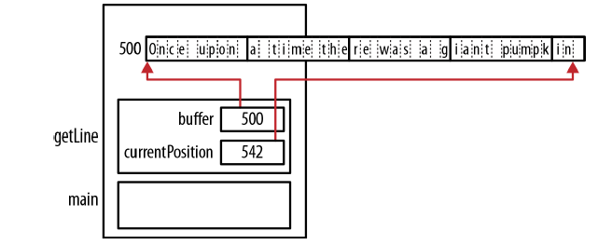

Slide 15
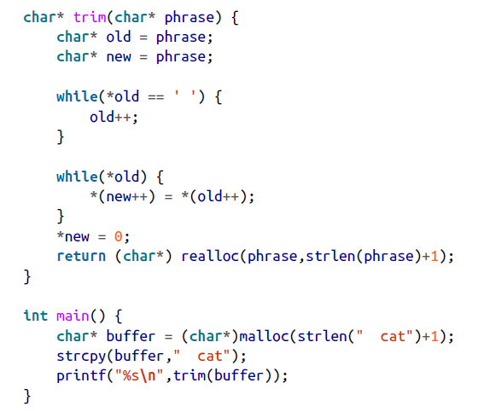
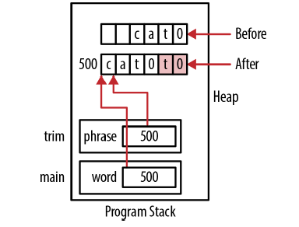
Old memory and should not be accessed

Slide 16
Passing a One-Dimensional Array
When a one-dimensional array is passed to a function, the array’s address is passed by value
This makes the transfer of information more efficient since we are not passing the entire array and
having to allocate memory in the stack for it
The array’s size must be passed

Slide 17
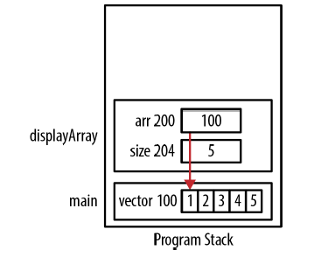
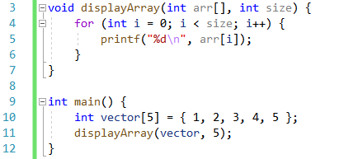
Passing a One-Dimensional Array: Using Array Notation
An integer array is passed to a function along with its size
The program may terminate if we attempt to address memory outside of the array’s bounds

Slide 18
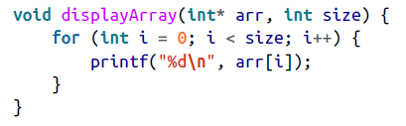
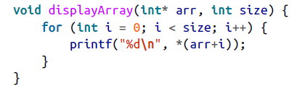
Passing a One-Dimensional Array: Using Pointer Notation
We don’t have to use the bracket notation when declaring an array parameter of a function
We could have used pointer notation in the function

Slide 19
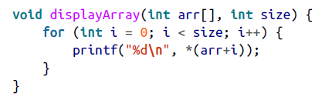
If we had used array notation to declare the function, we could have still used pointer notation
in the function’s body

Slide 20



